Slide 1
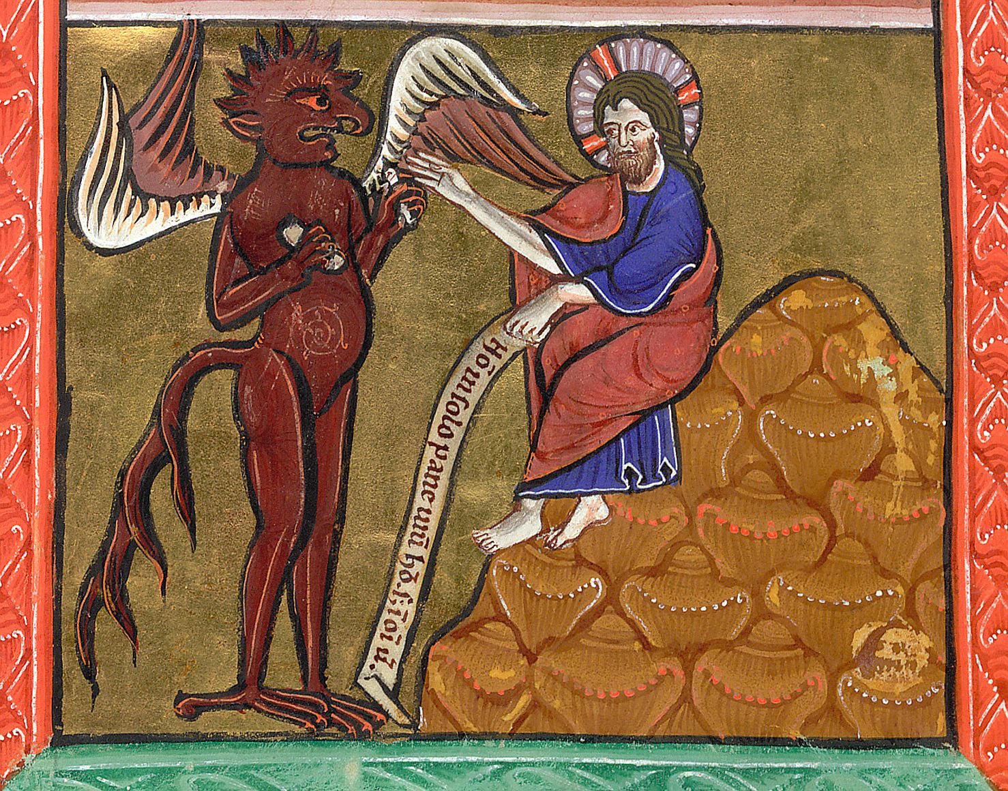

Slide 6
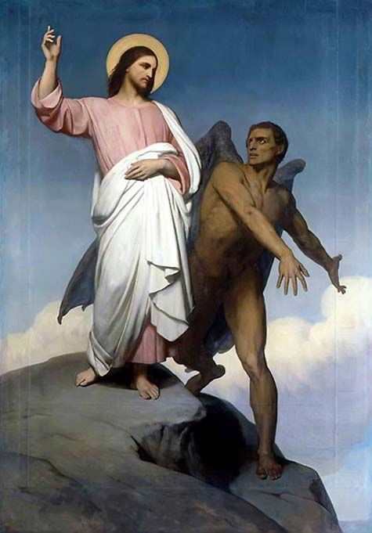

Slide 9
2 Remember how the LORD your God led you all the way in the wilderness these forty years, to humble and test you in order to know what was in your heart, whether or not you would keep his commands.

Slide 10
3 He humbled you, causing you to hunger and then feeding you with manna, which neither you nor your ancestors had known, to teach you that man does not live on bread alone but on every word that comes from the mouth of the LORD. Deut. 8:2-3

Slide 13
13 When Jesus came to the region of Caesarea Philippi, he asked his disciples, “Who do people say the Son of Man is?” 14 They replied, “Some say John the Baptist; others say Elijah; and still others, Jeremiah or one of the prophets.”
15 “But what about you?” he asked. “Who do you say I am?”

Slide 14
16 Simon Peter answered, “You are the Messiah, the Son of the living God.”
17 Jesus replied, “Blessed are you, Simon son of Jonah, for this was not revealed to you by flesh and blood, but by my Father in heaven. 18 And I tell you that you are Peter,[b] and on this rock I will build my church,

Slide 15
and the gates of Hades[c] will not overcome it. 19 I will give you the keys of the kingdom of heaven; whatever you bind on earth will be[d] bound in heaven, and whatever you loose on earth will be[e] loosed in heaven.” 20 Then he ordered his disciples not to tell anyone that he was the Messiah.

Slide 16
21 From that time on Jesus began to explain to his disciples that he must go to Jerusalem and suffer many things at the hands of the elders, the chief priests and the teachers of the law, and that he must be killed and on the third day be raised to life.
22 Peter took him aside and began to rebuke him.

Slide 17
“Never, Lord!” he said. “This shall never happen to you!” 23 Jesus turned and said to Peter, “Get behind me, Satan! You are a stumbling block to me; you do not have in mind the concerns of God, but merely human concerns.”

Slide 18
24 Then Jesus said to his disciples, “Whoever wants to be my disciple must deny themselves and take up their cross and follow me. 25 For whoever wants to save their life[f] will lose it, but whoever loses their life for me will find it. 26 What good will it be for someone to gain the whole world, yet forfeit their soul? Matt 16:13-26

